Slide 1



SESSION 1 : Briefing About R and RStudio

Slide 2
R Programming Language
R is a language and environment for statistical computing and graphics. It is a GNU project which was developed at Bell Laboratories (formerly AT&T, now Lucent Technologies) by John Chambers and colleagues.
R provides a wide variety of statistical (linear and nonlinear modelling, classical statistical tests, time-series analysis, classification, clustering, …) and graphical techniques, and is highly extensible.
https://cran.r-project.org/
Current R version : R-4.1.1
R (Integrated Suite of Software facilities)
Effective data handling and storage facility
A suite of operators for calculations on arrays and matrices
Graphical facilities for data analysis
A large, coherent, integrated collection of intermediate tools for data analysis
Includes conditionals, loops, user-defined recursive functions & input and output facilities.

Slide 3
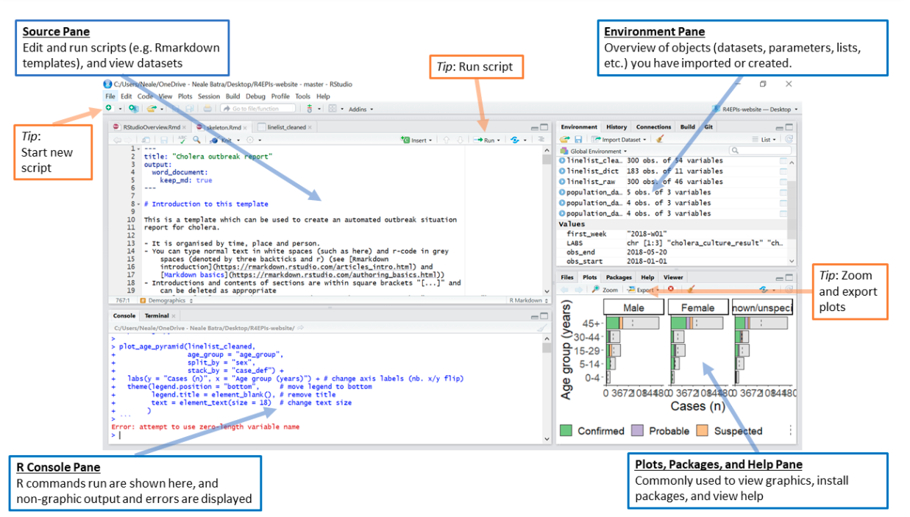
RStudio
RStudio is an Integrated Development Environment (IDE) for R, a programming language for statistical computing and graphics.
Unlike many other statistical software packages in which a graphical user interface is employed, a typical user interacts with R primarily through the command line.
An IDE for R include a means for issuing commands interactively.

Slide 4
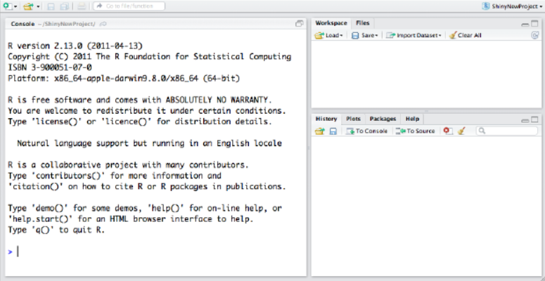
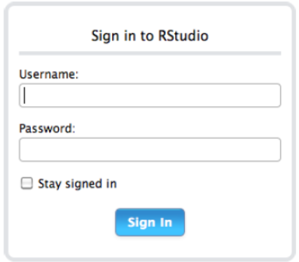
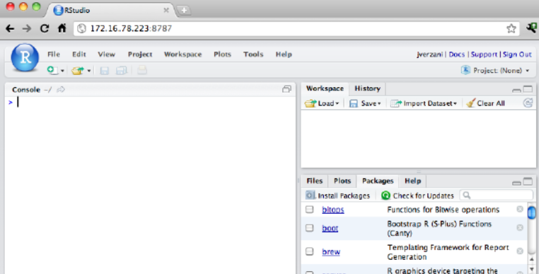
Why RStudio
Easier and more productive to use R
4-panel layout
That includes a console for interactive R sessions,
A tabbed source-code editor to organize a project’s files, and
Panels with notebooks to organize less central components.
Source-code editor is feature-rich
Setting up different projects is a snap, and switching between them is even easier.
Easy-to-use administrative tools for managing packages, the workspace, files, and more.
DESKTOP
SERVER
Console, Workspace, History
Enables you to provide a browser based interface to a version of R running on a remote Linux server,
Mac: Icon in App, Windows: Desktop, Linux: rstudio command

Slide 5
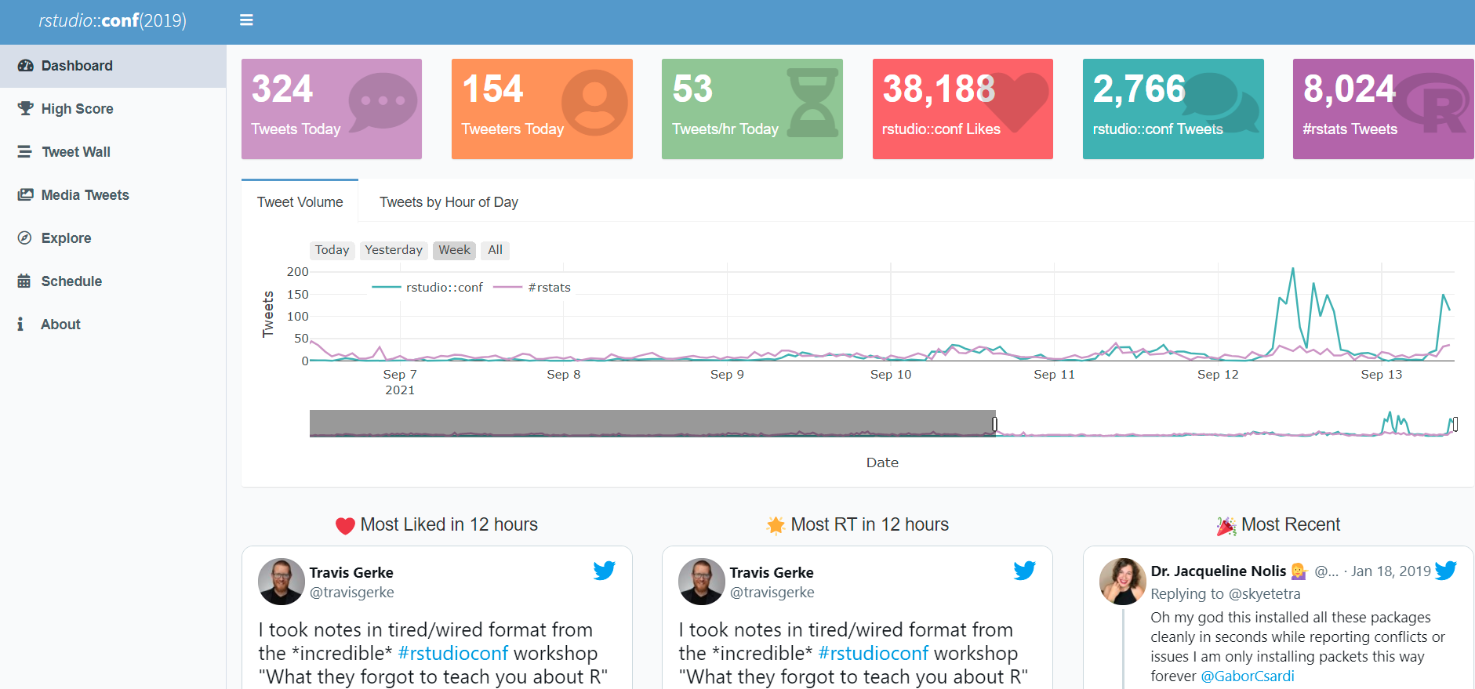
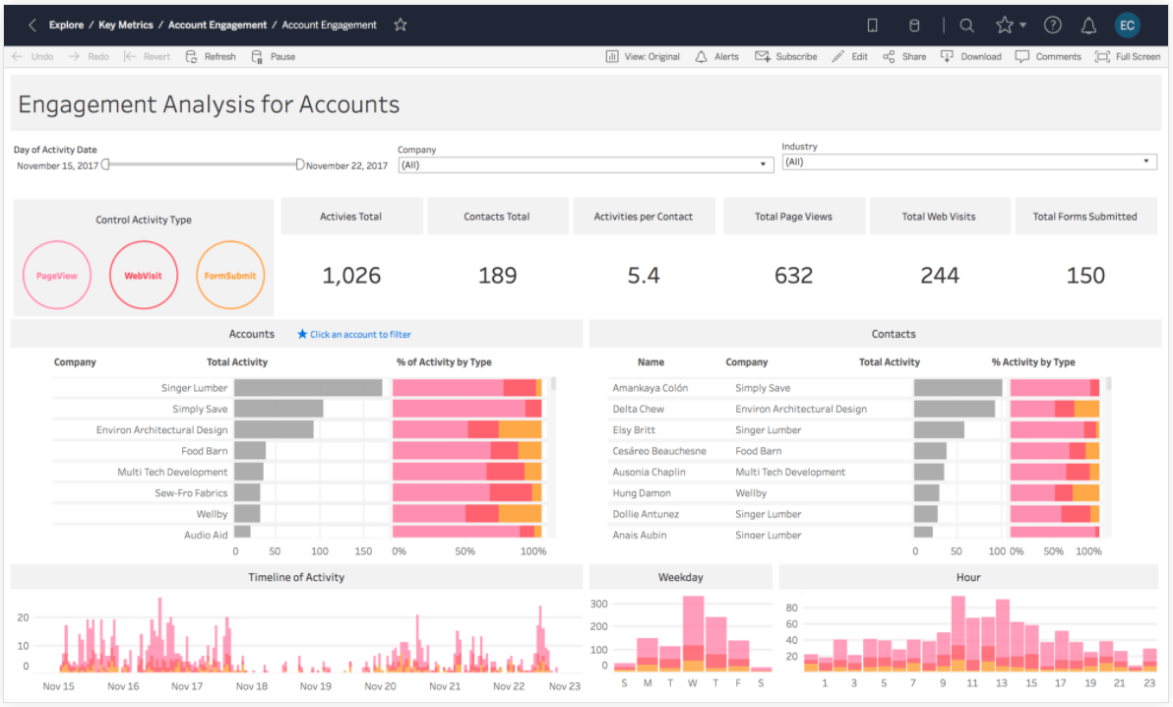
Subtle Comparison with other Tools
R Shiny, flexdashboard
Tableau/Power BI/Qlik View
Source
Source
https://gadenbuie.shinyapps.io/tweet-conf-dash/?_ga=2.121046656.984439988.1631514451-767271589.1623651113
https://www.tableau.com/products/cloud-bi
Pricing >> Free of Cost
Pricing >> 70$ user/month billed annually
R & Shiny combine both Machine Learning & decision making
Cannot do decision making on its own. Its for dashboarding primarily
Application security not limited to terms and condition, can be customized without much cost
Application security limited to terms and condition and customization can be expensive

Slide 6
Subtle Comparison with other Tools
R Vs Python

Slide 7
Application Development (API) using Postman + Plumber in R Vs Python ……

Slide 8
RStudio
R is not unique in this respect, and IDEs for interactive scientific programming languages have matured to include features such as:
CONSOLE
SOURCE CODE EDITOR
OBJECT BROWSER
Development involves the act of programming & this task is inevitably done with a source-code editor.
An object browser allows the user to identify quickly the type and values for each such variable.
A console for issuing commands.
OBJECT EDITOR
DOC INTEGRATION
PLOT MANAGEMENT
A means to inspect or edit objects is typically provided
We can see the documentation
We can manage
the plotting

Slide 9
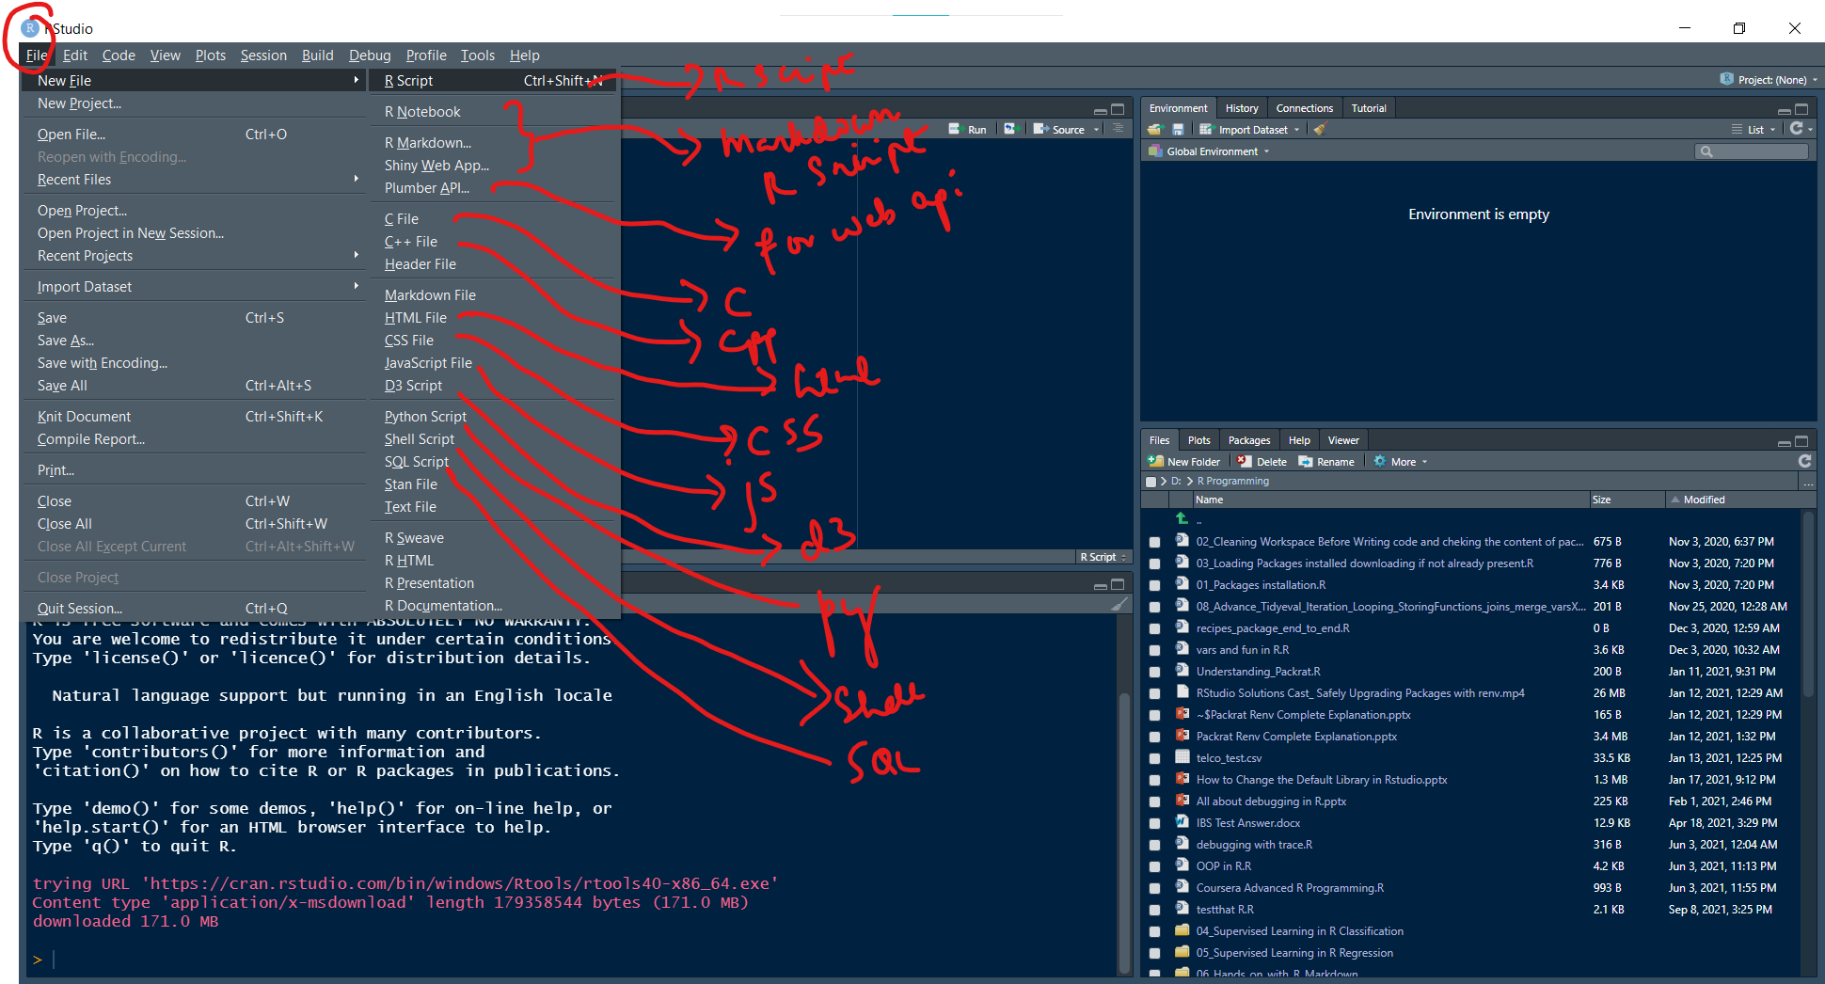
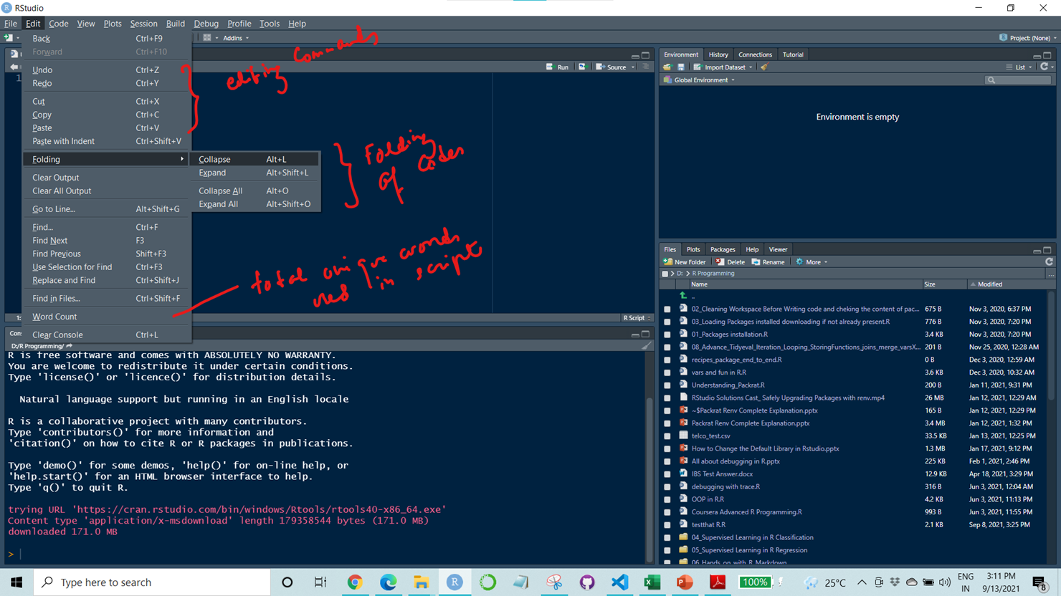
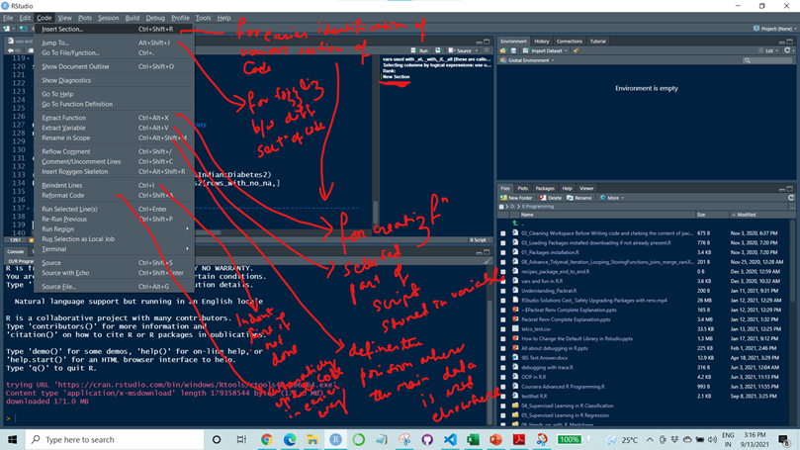
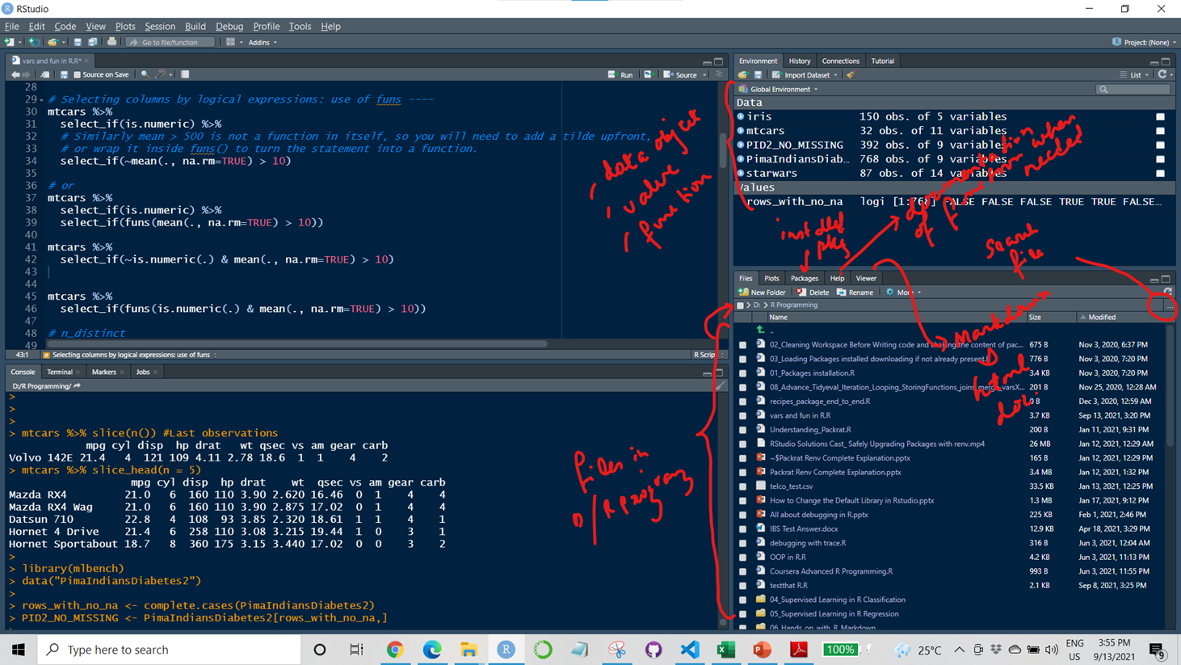
File Tab
Edit Tab
Code Tab
Environment, File/Plots/Pkg/Viewer

